Slide 1
CSI 201
Skills Lab 1
IV and Venipuncture
Daryl P. Lofaso, Ph.D., M.Ed., RRT

Slide 2
Indications for IV
Indications:
    Intravenous access to patient’s circulatory system.
    Administration of Meds. & Fluids, as well as blood collection
Contraindications:
    IV access should be attempted as distal as possible.
    Avoid veins that cross over joints, local infection/injury
    Extremities with renal shunts or fistulas

Slide 3
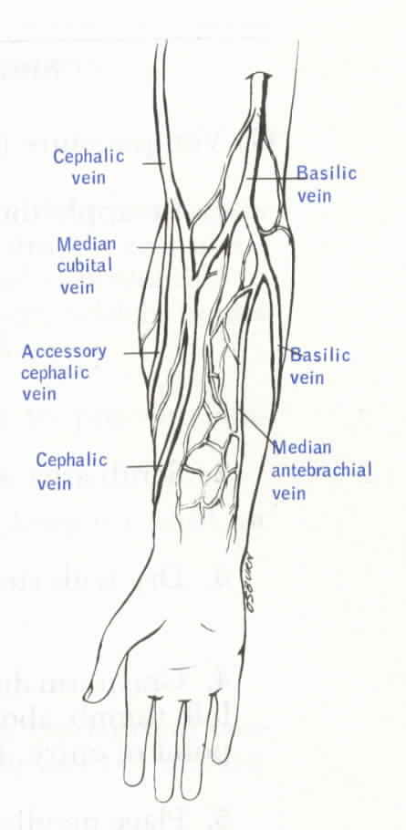
Common IV sites

Slide 4
IV catheter size
Age
    < 1 year: 22, 24 gauges (g)
    1-8 years: 18, 20, 22 gauges
    > 8 years: 16. 18, 20 gauges

Slide 5
IV Procedure
Use universal precautions (glove and eye protection)
Allergies (betadine, latex or topical anesthetic)
Explain procedure to patient
Prepare all material (IV cath, starter kit, connection tub and flush)
Apply tourniquet above the elbow. Select vein.
Prepare site (air dry)

Slide 6
IV Procedure (cont.)
Warn the pt. of possible pain
Bevel up at 30 degree above horizontal
Look for flashback of blood into catheter
Upon seeing flashback, advance catheter another millimeter or two. Decrease catheter to near “0” horizontal.
Advance the sheath completely into the vein and release tourniquet

Slide 7
IV Procedure (cont.)
Connect the IV tubing/heplock
Confirm placement by aspirate and flush
Secure catheter and tubing
Dispose of needle in sharps container
Document the IV site, catheter size, and date in patient’s EMR

Slide 8
Risks to YOU
Risks after needle Sticks Exposure
    Hepatitis B: 6 - 30%
    Hepatitis C: 3 - 10%
    HIV: 0.3 %
Other blood borne pathogens

Slide 9
Steps to prevent needle sticks
Wear gloves
Do Not Bend or Break Needles
Never RECAP!!!
If you must, use the One Handed technique
Take your time
Dispose of contaminated needles immediately in puncture-resistant containers

Slide 10
POLICY ON ACCIDENTAL NEEDLE STICKS
Immediately wash injured area with soap and water.
Report all needle sticks immediately to your instructor or immediate supervisor.
Complete an incident report and report to employee health or ED.
Determine if the needle was clean or dirty.
Cleansing wound with antiseptic.
Request that the identified patient be tested for Hepatitis B surface antigen and HIV antibodies.
Have your blood tested for Hepatitis B and HIV antibodies as soon as possible.
Begin drug treatment (if necessary) & counseling.

Slide 11
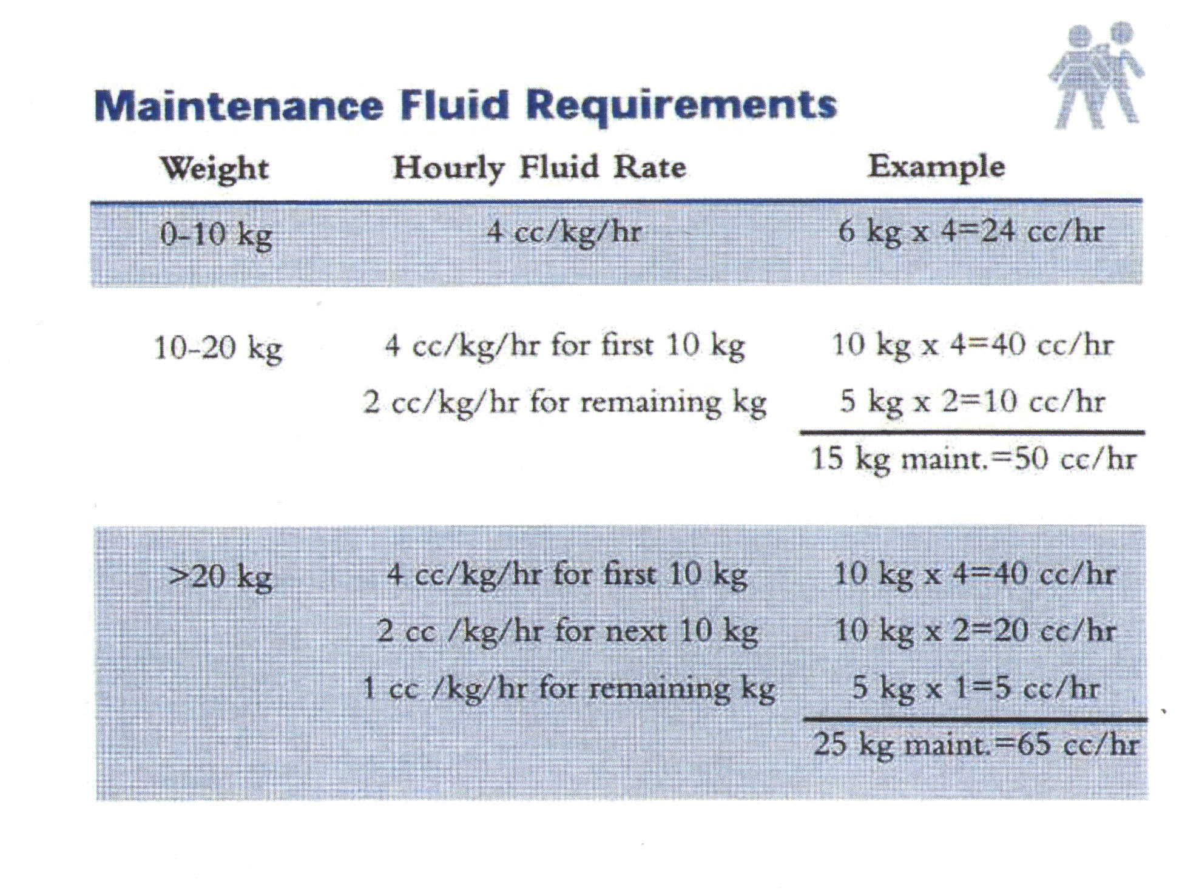
How to calculate patient’s fluid rate
Maintenance Fluid: Adult or Peds

Slide 12
Fluid Disturbances
Isotonic Imbalances
    Fluid volume deficit
      Losses from GI
      Loss of plasma or whole blood
      Fever
      Diuretics
    Fluid volume excess
      CHF
      Renal Failure
      Cirrhosis of liver

Slide 13
Fluid Disturbances (cont.)
Osmolar Imbalances
    Hyperosmolar imbalance
      Diabetic ketoacidosis
      Osmotic diuresis
    Hypoosmolar imbalance
      SIADH
      Excess water intake

Slide 14
Electrolyte Imbalances
Hyponatrema
Hypernatrema
Hypokalemia
Hypocalcemia
Hypercalcemia
Hypomagnesemia
Hypermagnesemia

Slide 15
Risk Factors for Fluid, Electrolyte, and Acid-Base Imbalances
Age
    Very old or very young
Chronic disease
    CA or Cardiovascular disease (CHF)
Trauma
    Crush or head injuries or burns
Therapies
    Diuretics, steroids, IV therapy, TPN
Gastrointestinal losses
    Gastroenteritis, NG Suction or fistulas

